Slide 1
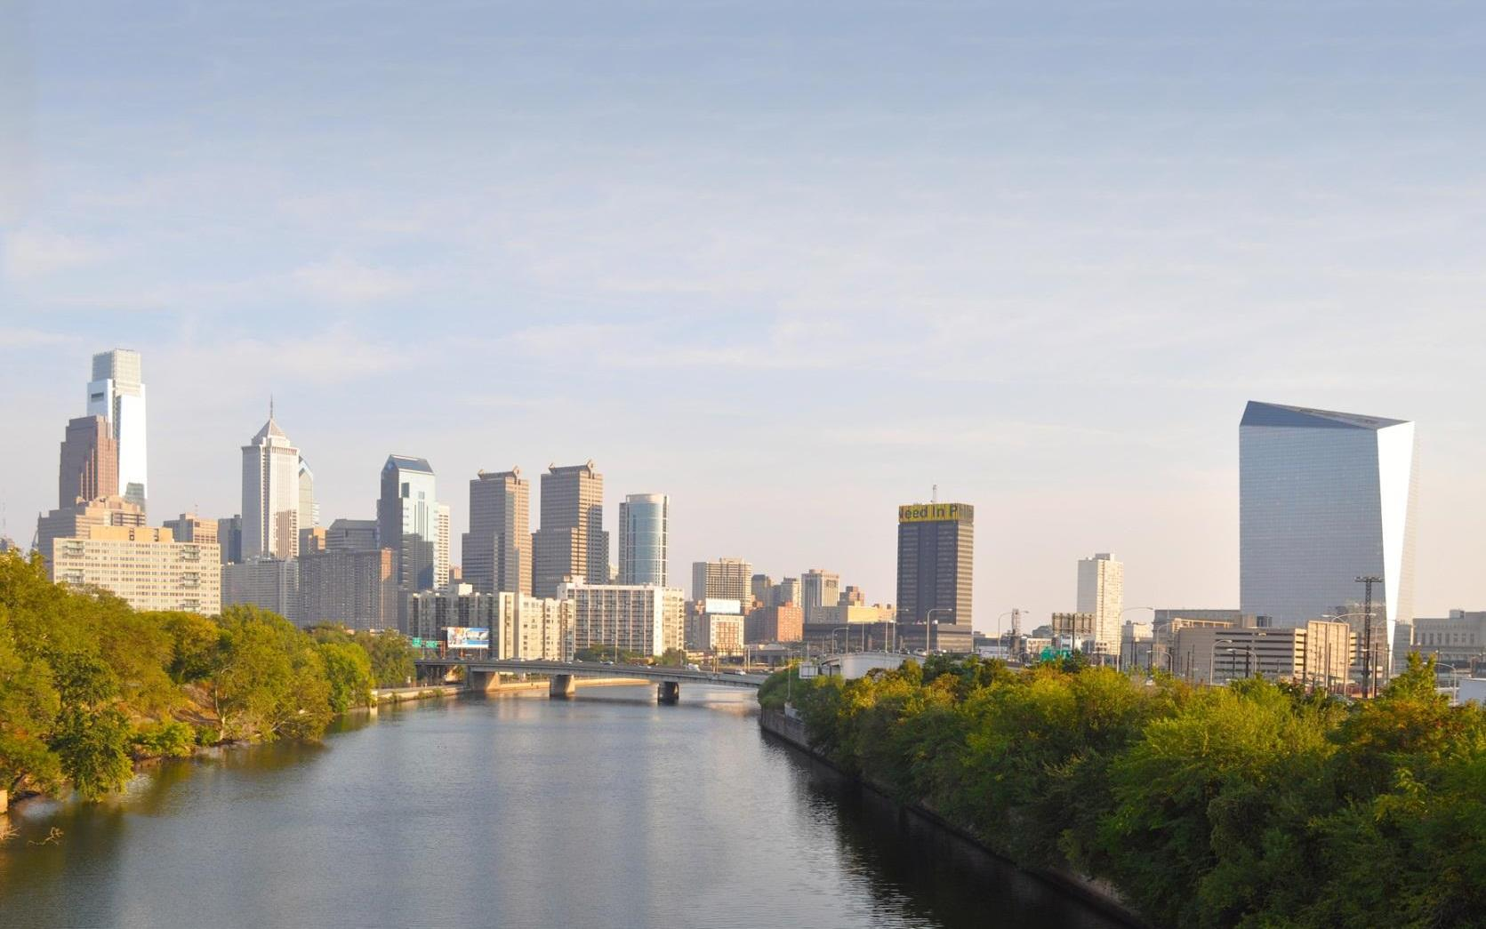
Green Stormwater Infrastructure in Philadelphia
American Street Case Study
Elizabeth Svekla, AICP
Planning Manager, GSI Unit
Elizabeth.Svekla@phila.gov

Slide 2
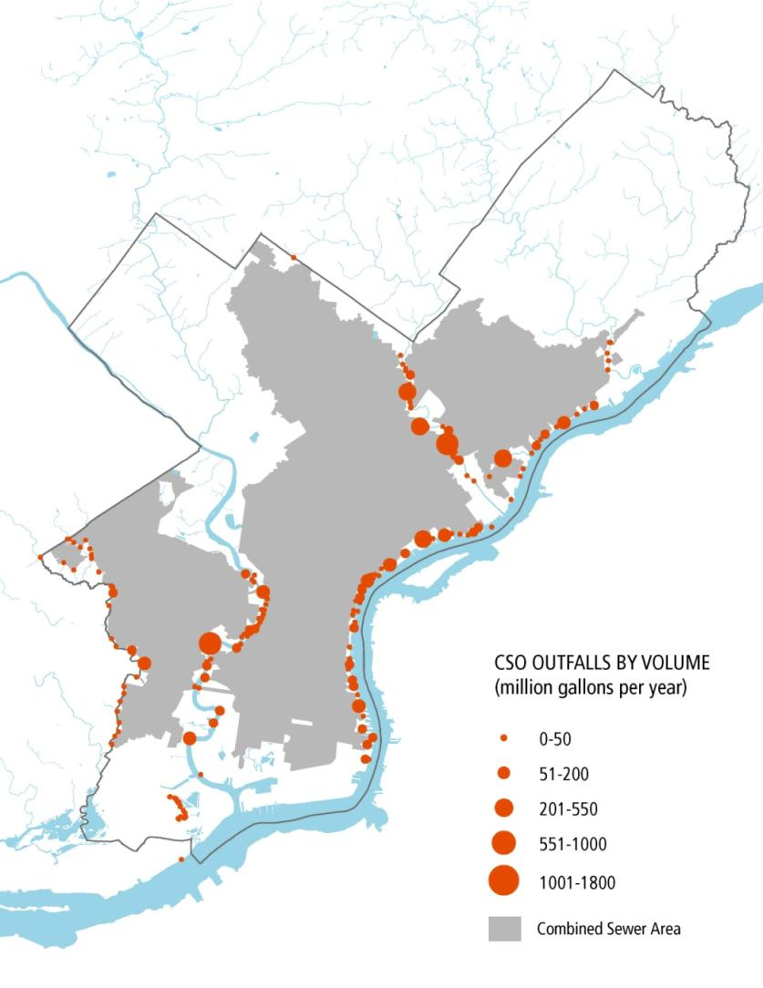
Philadelphia’s Infrastructure
Notes:
This map shows the Philadelphia city limits in relation to our two major rivers the Delaware and Schuylkill. The central portion of the city (approximately 2/3) is serviced by combined sewers that have outfalls to our waterbodies shown in orange. PWD has various teams of staff dedicated to reducing the volume of contaminated water discharged into our rivers and streams and improving water quality.

Slide 3
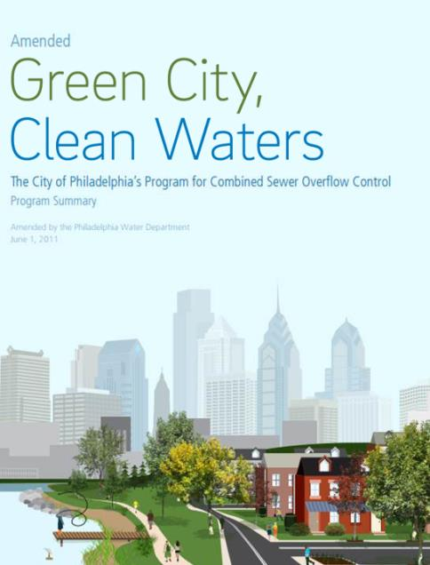
Our Plan
Green City, Clean Waters seeks
to protect and enhance Philadelphia’s watersheds by managing stormwater with green stormwater infrastructure (GSI)
25 year program
Goals are approximately 10,000 greened acres and 85% overflow reduction
Provide triple bottom line benefits to our communities
Notes:
In 2011, the City entered into a Consent Order and Agreement with the PADEP for the implementation of PWD’s Combined Sewer Overflow Long Term Control Plan. Partnership agreement with EPA signed in 2012. Our 25 year program has 5 year milestone/targets that must be accomplished to stay in compliance. The 25 year target of accomplishing 10,000 greened acres means that over 1/3 of the impervious services we see today in the CS Area will be managed through green practices and diverted away from our existing infrastructure. We exceeded our 5 year target and almost 8 years in, we are projected to hit or exceed our year 10 target of 2,148GAs.

Slide 4
How is GSI built in Philly?
Stormwater Regulations (Development)
Incentivized Retrofits
(SMIP/GARP)
Public Retrofits
(Green Streets, Parks, Facilities, etc.)
Green City, Clean Waters Goals
Notes:
There are 3 main ways green stormwater infrastructure is built in the city. Through private means during redevelopment, through retrofits incentivized by our SMIP/GARP grants and through our public programs. As Jillian mentioned previously in the last 2 years, all of these programs have been consolidated under one green infrastructure unit which has allowed PWD to plan more holistically regardless of landuse type or ownership. We want to encourage the implementation of quality SMPs across programs.

Slide 5
Planning Strategy
Maximize Drainage Capture
Consider Site Context
Coordinate With Partners
City Council
City Agencies
Community Organizations
Private Property Owners
Balance PWD’s objectives with community needs
Notes:
During the planning phase, PWD identifies and prioritizes locations for GSI to be implemented across the city. These opportunities aim to maximize drainage area capture and water quality benefits. The planning team provides value to the GSI implementation process by providing a holistic look at how GSI aligns with larger planning initiatives. Planners conduct extensive coordination with partner agencies such as City Council, Parks and Recreation, and Streets to identify short-term and long-term priorities for implementation. Planners also coordinate with community stakeholders to balance PWD’s objectives with community needs.

Slide 6
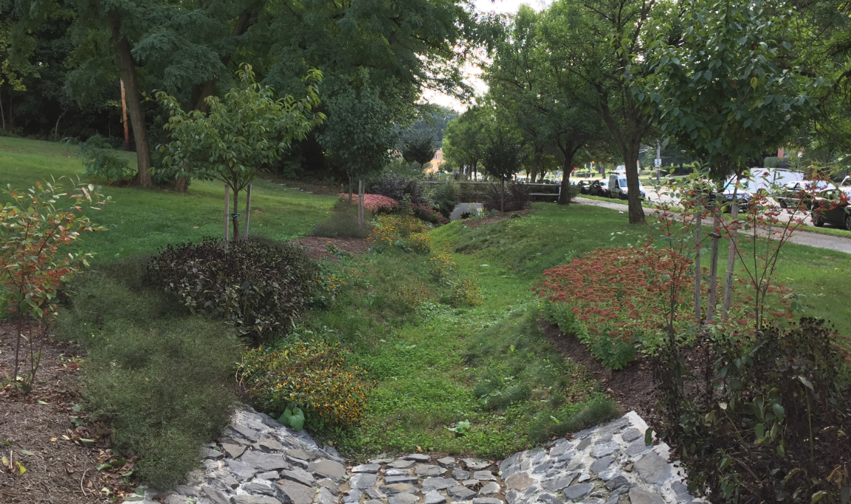
Parks

Slide 7
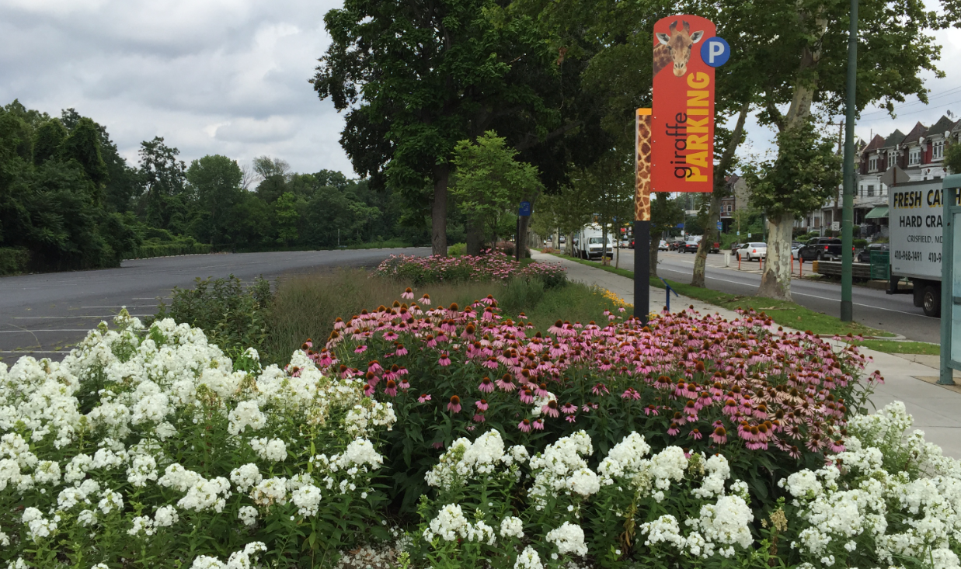
Facilities

Slide 8
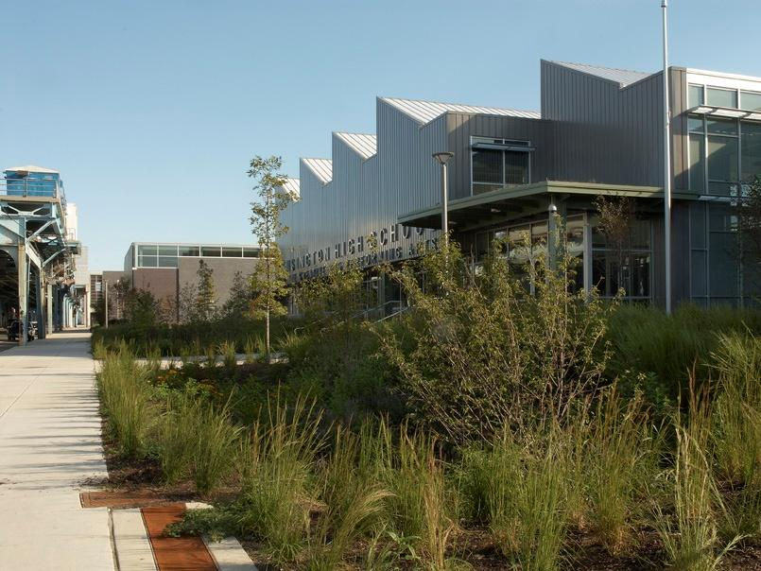
Schools

Slide 9
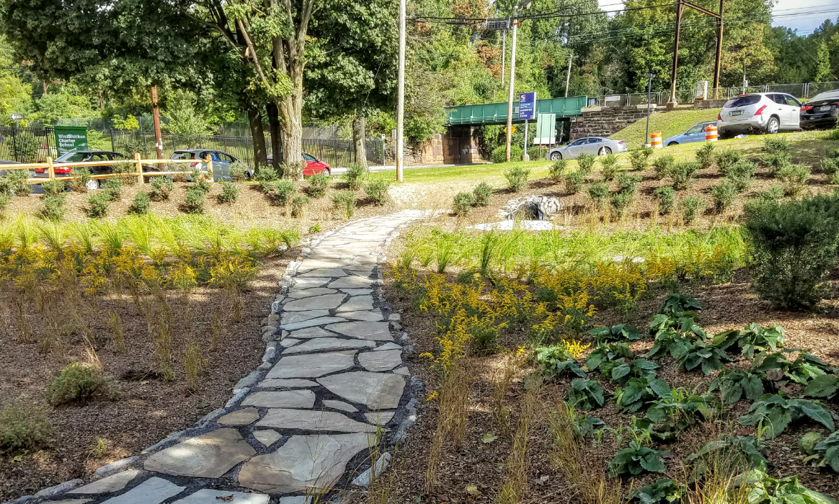
Vacant Land

Slide 10
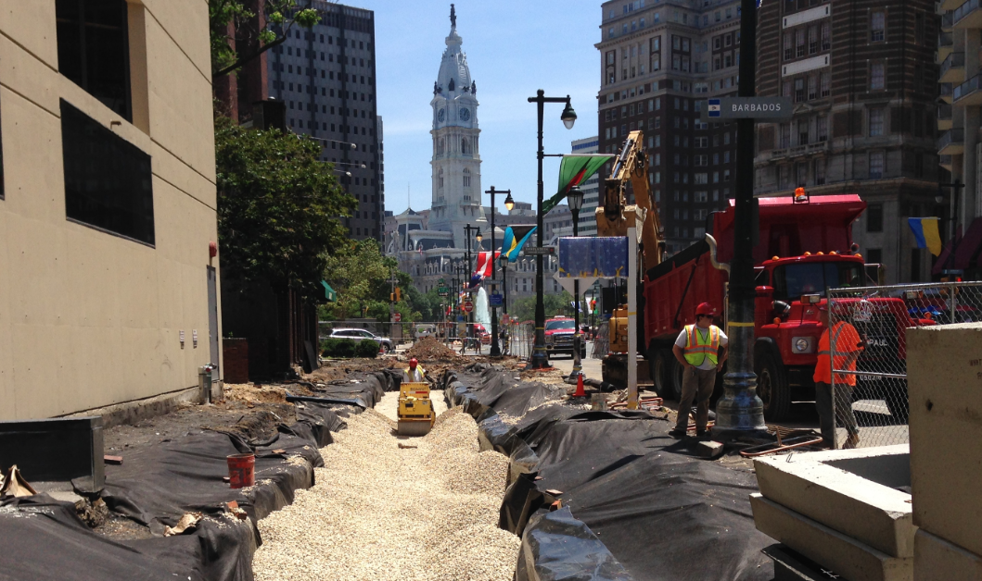
Streets

Slide 11
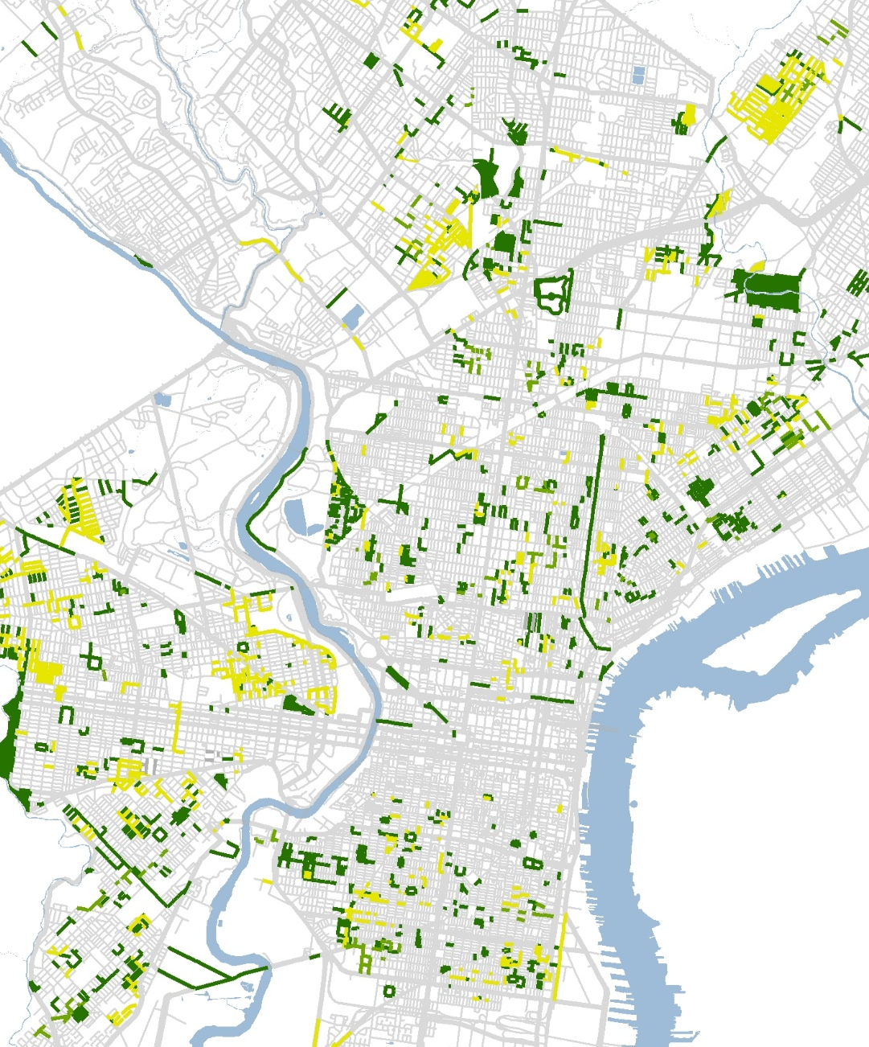
American Street Project
General Context
2 mile corridor located north of Center City
Highly impervious area
120’+ wide ROW
Abandoned/obsolete tracks present down centerline
Commercial uses with large truck traffic in a rapidly changing neighborhood
Multiple stakeholders
Community suffering from planning fatigue

Slide 12
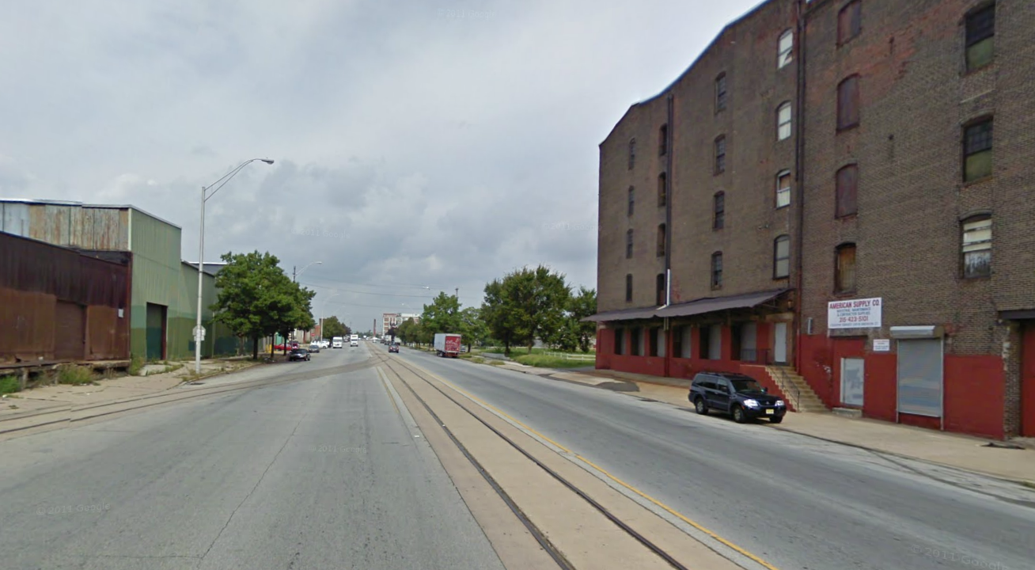
American Street Project
Existing Conditions

Slide 13
American Street Project
Design Development
Notes:
We started by doing an assessment of underground utilities to find where there was available space to locate the GSI footprints at a very basic level – under the footway or in the median and get a better handle on all the constraints. Because the center median had always had rail track no other infrastructure had be placed there.

Slide 14
American Street Project
Partners
FHWA and PennDOT
Streets Department
Commerce Department
Mayor’s Office of Transportation and Infrastructure Systems
City Council
Local Community Groups
Business Owners
Funding
TIGER grant funding
Streets Department Capital Funds
Commerce Department
Water Department Capital Funds
Funding and Project Team
Notes:
This corridor had long been on the city’s list for large scale improvements, and in 2015 the city was awarded TIGER grant funding to make the planning a reality. The timelines were extremely tight especially for a project of this size and complexity. We worked with partners such as our Streets Department, Commerce Department (BID contracts), Office of Transportation and Infrastructure Systems (bike infrastructure, ped improvements). Streets Department wound up taking the lead on applying for TIGER funding which allocated 5 million dollars to the removal of the old tracks, making it possible for GSI to be placed cost effectively in the median.

Slide 15
American Street Project
Design Process

Slide 16
American Street Project
Extensive Outreach
Stakeholder groups
Series of public meetings to present design options and gather feedback
One-on-one engagement of the businesses and landowners along the corridor
Design Process

Slide 17
American Street Project
Challenges and Wins
Notes:
Balancing everyone’s priorities, business needs vs. community wants. Political pressure. Sometimes stormwater design can drive curbline decisions and other times compromises need to be made. Long term maintenance is always a concern and that burden was considered early on in the process.
We were able to accomplish a lot on a quick timeline because people were forced to make hard decisions. This will be the longest stretch of a truly, complete street design in the city to date and can be used as a model moving forward.

Slide 18
American Street Project
What’s Next
Notes:
Utilizing the new infrastructure in the street to manage stormwater from adjacent properties. Finding the next American Street.

Slide 19
Notes:
Utilizing the new infrastructure in the street to manage stormwater from adjacent properties. Finding the next American Street.

