Slide 1
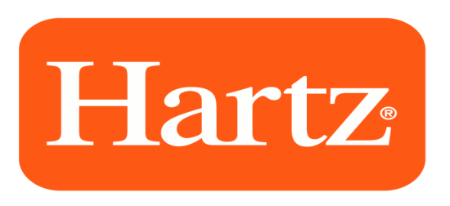
The Hartz Mountain Corp
Solution implementation during COVID
Provided by Norma

Slide 2
Technology
Upgraded technology infrastructure providing all employees with laptops - many employees had desktop computers
IT department created shared drives allowing ea. department to house shared documents and information
Implemented New HR / payroll vendor – going paperless
  Self service environments for employees and managers to bring onboarding, time off requests, benefit enrollments and performance reviews online

Slide 3
Collaboration
Rolled out Google Meet technology to connect departments and vendors with face to face meetings
  Required computer cameras be turned on during meetings.
  Used cell phones communicate quickly for one-on-one calls with colleagues and teams
Managers hold daily virtual meetings with their team to keep teams connected and generate live “think tank” collaboration.

Slide 4
Communication
CEO ramped up his communications providing frequent updates on the viability of the company (via email) and holds virtual town halls meetings with all departments (interactive via Google Meet)

Slide 5
Recruitment
We have continued to hire during the pandemic, adopting our recruitment and onboarding procedures for the new and virtual world.

Slide 6
Recruitment cont.
All interviews with candidates are conducted via Google Meet
Switched from holding multiple interviews to 1-2 panel interviews with the hiring manager and stakeholders reducing hiring time by 50%
Onboarding tasks are now completed online within our HRMS technology
New Employee Orientation is held virtual via Google Meet

Slide 7
Return to Work Plan
Extended work from home program through the end of August 2021
  NJ Offices are open and employees can go to the office on a voluntary basis
September 2021 - March 2023
  hybrid schedule will be adopted with employees working 25% of the time in the office

Slide 8
Health & Safety

