Slide 1

Together
New Jersey:
Challenges & Changes Literacy New Jersey*
Elizabeth Gloeggler, egloeggler@literacynj.org
* in a pandemic

Slide 2
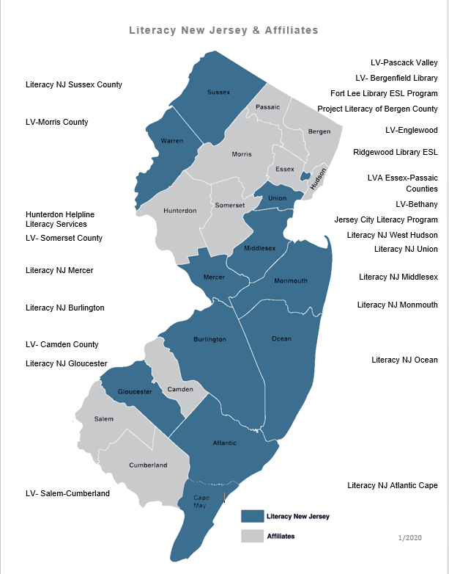

Literacy NJ today
Link to pdf
Notes:
Merged 9 nonprofits in 2014 ...added 2 in 2019. What do we do: It is our job to make sure that every adult in NJ can read write and speak english so they can achieve their goal. We have a staff of 21 and 10 offices around NJ.

Slide 3

Some context:
Realistically 11% of nonprofits close their doors every year.
COVID could account for an additional 7% or more.
In the most dire scenario, we lose 119,517 nonprofits (38%).
How many nonprofits will close their doors by Jacob Harold on Candid, July, 2020
Notes:
But there are strategies that could make a difference, such as scenario planning, collaboration, restructuring, and innovative finance. Choices made by government and foundations will matter, and nonprofits have an opportunity to influence those choices.

Slide 4

Some context:
# of students receiving remote instruction from October, 1979-March 15, 2020: 0
# of students receiving remote instruction in just 10 of our programs from March 16, 2020 to today: 1,519
# of staff laid off or furloughed: 0

Slide 5

Our Pandemic Mantras
We’re not thinking about what’s impossible ...we’re thinking about how to make things possible.
Don’t tell us something is hard … everything is hard right now ...tell us what you’re going to do or try.
You’re not alone … you’re part of a team!

Slide 6
Top 3 COVID Challenges*
* aka everyday as I try to keep my literacy program alive!
Nothing was VIRTUAL
Staff Entrenchment
Money … money … money
Notes:
Virtually no remote learning, students with limited access to the digital world and limited digital literacy skills and volunteers (and sometimes staff) who were reluctant to try new things.
Staff in their local offices … most with desktops ...used to just serving their area.

Slide 7
Top 3 COVID Innovating*
* aka everyday as I try to keep my literacy program alive!
Nothing was VIRTUAL
  Fixed our curriculum, trained our volunteers, got devices for our students, met our students where they are digitally.
Staff Entrenchment
  Erased the borders, trained together, taught together, did projects together.
Money … money … money
  We left no stone unturned, chased down every possible opportunity.
Notes:
Virtually no remote learning, students with limited access to the digital world and limited digital literacy skills and volunteers (and sometimes staff) who were reluctant to try new things.
Staff in their local offices … most with desktops ...used to just serving their area.

Slide 8
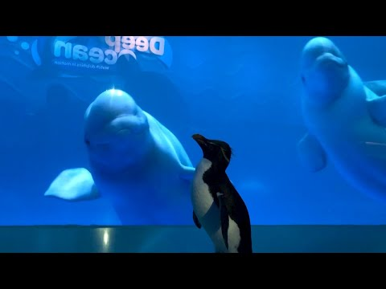
Thank you!

